Slide 1
Git Advanced
Module 3 – Continuous Integration

Slide 2
Continuous Integration Module 3 contents
Branching and Merging
Merge Conflicts
Reverting, rebasing and reviewing

Slide 3
Branching and Merging
Continuous Integration – Module 3: Git Advanced

Slide 4
Branches in Git
Branching in Git helps us to define workflows that make sure the code that is being delivered is in the best state possible
Minimises risks for any errors or crashes
With version control systems like Git, we can separate the codebase on to many different branches
Useful for cases such as isolating the development and testing of new features from working code that is running on a production environment
The two main branches that exist are the develop and master branches

Slide 5
The Master branch
By default, the master branch is the only branch created in a Git repo
This could be named anything in reality, but master is a simple naming convention
After cloning a repository from a remote repository, the local repository will have the master branch present
From here, we can create multiple branches for different features

Slide 6
The Develop branch
New Features
Created in feature branches from the develop branch
Once the feature has been developed, the code can be reviewed by a peer in a Pull Request and deployed to a test environment for Integration or User Acceptance Testing
If all testing and reviews pass then the Pull Request can be approved and merged into the develop branch

Slide 7
Git Merging
Merging is a common practice within Git when working with branches
We’ve created what we need to create within a branch, now let’s put it all together!
The git merge command allows you to take all of the individual workflows of branches and integrate them
Focal part of the continuous integration process!
Git merge allows us to work with the tip of the feature and the master and combine them

Slide 8
Creating new branches
To create a new branch, use the git branch command
As with most other commands, git branch has a number of options
To begin working on this branch, use the git checkout command
This allows us to navigate between branches and start working on a branch
Adding the –b option simultaneously creates a new branch

Slide 9
Git - releases
When there is a release approaching, a release candidate branch can be made
On this new branch, further testing can take place, and more candidates can be made on this branch to amend any issues
Once testing has passed and the release has been signed off, the release candidate branch can be merged into master for the release to be deployed to a production environment
Once merged into the master branch, the code can be tagged or marked as a release
Changes must also be merged back into the develop branch, so that any changes that were made to the release candidate will also be included in future releases

Slide 10
Deleting branches
Deleting branches is typical within Git
Once work on an issue has been completed and successfully merged into the master, we can delete the branch
We wouldn’t need a branch called ‘login_feature’ if the login feature is complete! Rather, we would re-create the branch as and when we need it, not to further complicate the workflows
To delete a branch, use the git branch –d command
If there is work on the branch, Git will stop you from deleting the branch. To override this, use the –D flag!

Slide 11
Hotfixes
Hotfixes should be prevented where possible, but this isn’t always possible
A hotfix can be conducted by creating a hotfix branch from the master branch and applying the changes on that branch
Before merging back into the master branch all the changes should, of course, be tested and reviewed to avoid even more hotfixes!

Slide 12
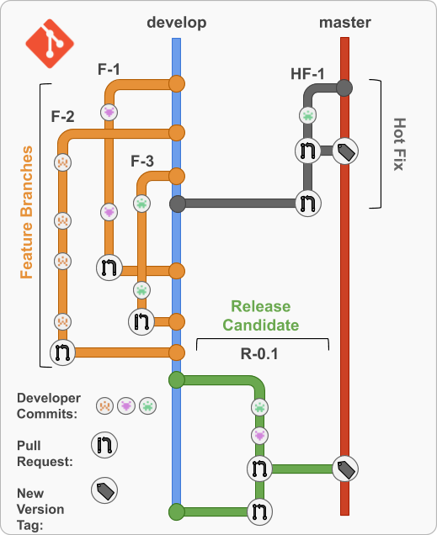
Git master-develop model

Slide 13
Task: Git branching
To utilise branches within your repository
Go to lab on Community
Complete the Branching module

Slide 14
Merge Conflicts
Continuous Integration – Module 3: Git Advanced

Slide 15
Merge conflicts
Not everything will go to plan at times…
As a project grows in the number of developers and files, there’s a chance redundant work is made.
If two people are working on the same file, we may run into merge conflicts
Git can typically figure out how to merge two files, but we can run into merge conflicts
If 2 developers have changed the same line in a file, this could bring up a merge conflict

Slide 16
Git merge conflicts
Developer 1
package com.qa.tracker.constants;
public interface Constants {
static final String GET_TRAINER_BY_ID = "/getTrainer/{trainerId}";
static final String GET_ALL_TRAINERS = "/getAllTrainers";
static final String SAVE_TRAINER = "/saveTrainer";
static final String TRAINER = "/trainer";
static final String HOME = "/home";
static final String INDEX = "index";
}
Both developers have been working on this file at the same time - how does Git know which file is correct?
Simply speaking, it doesn’t as the same lines have been edited differently in the same file
Git cannot take a wild guess as to which is correct!
We will need to resolve the conflict ourselves by editing the file
Developer 2
package com.qa.tracker.constants;
public interface Constants {
static final String GET_TRAINER_BY_ID = "/getTrainer/{trainerId}";
static final String GET_ALL_TRAINERS = "/getTrainers";
static final String SAVE_TRAINER = "/saveTrainers";
static final String TRAINER = "/trainers";
static final String HOME = "/home";
static final String INDEX = "index";
}

Slide 17
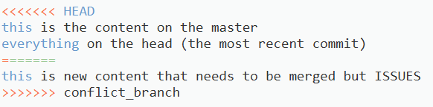
Resolving conflicts
The easiest way to resolve a conflict is to directly edit the file in question
The HEAD (most recent commit) will have its content between HEAD and the content divider ( ==== )
Comparatively, the conflict in question will be between the content divider ( ==== ) and the branch name

Slide 18
Task: Merging and conflicts
To experiment with merging content and merge conflicts within your repository
Go to Community
Complete the merging module

Slide 19
Reverting, rebasing and reviewing
Continuous Integration – Module 3: Git Advanced

Slide 20
Reverting in Git
Everyone makes mistakes, so it’s important that we know how to rectify them!
You can revert to a previous commit in 3 ways:
git checkout
git revert
git reset
These allow you to go back to a previous commit, before any errors were made…
Notes:
Revert – Creates a new commit that undoes previous changes in the last commit. Will modify history.
Checkout – checkout to another branch, dropping changes; you can use stash to save files.
Reset – Modification of the staging area, changes head pointing; can alter history

Slide 21
Task: Reverting in Git
To experiment with reverting within your repository
Go to lab on Community
Complete the reverting module

Slide 22
Git - rebasing
Feature
Feature
*
*
* - new commit
Master
Rebasing is the process of moving or combining a sequence of commits to a new base commit
Makes it appear as if you'd created your branch from a different commit
Internally, Git accomplishes this by creating new commits and applying them to the specified base
It's very important to understand that even though the branch looks the same, it's composed of entirely new commits

Slide 23
Git – ignoring files
Git sees all files in your working repo as tracked, untracked or ignored
There are files that we don’t want pushed onto our repo
This could be logs, artefacts, system files, key files and more
To ensure these types of files aren’t committed and/or pushed to our repository, we use the .gitignore file
This file must be edited and configured by the user in the same way any text document would be
Works with verbose file names as well as with file globbing

Slide 24
Reviewing in Git
Reviews allow collaborators to:
Comment on the changes proposed in pull requests
Approve the changes
Request further changes before the pull request is merged
Repository administrators can require that all pull requests are approved before being merged
Reviews allow for discussion of proposed changes and help ensure that the changes meet the repository's contributing guidelines and other quality standards
Reviews take place using the GitHub GUI

Slide 25

Thank you for listening
Any questions?

Slide 26
summary
We can utilise branches within Git to separate workflows
The master-develop architecture is a prime example of this
We can also ignore files through the .gitignore file
Merging is combining 2 different branches
There are times where conflicts could arise, but they can be resolved by editing the files
We also have the ability to revert, rebase and review within Git through the UI
Continuous Integration - module 3

